Slide 1

Note: The data and information in this document is reflective of a hypothetical situation and client. This document is to be used for KPMG Virtual Internship purposes only.
Sprocket Central Pty Ltd
Data analytics approach
[Division Name] - [Engagement Manager], [Senior Consultant], [Junior Consultant]

Slide 2
Note: The data and information in this document is reflective of a hypothetical situation and client. This document is to be used for KPMG Virtual Internship purposes only.
Agenda
Introduction
Data Exploration
Model Development
Interpretation

Slide 3
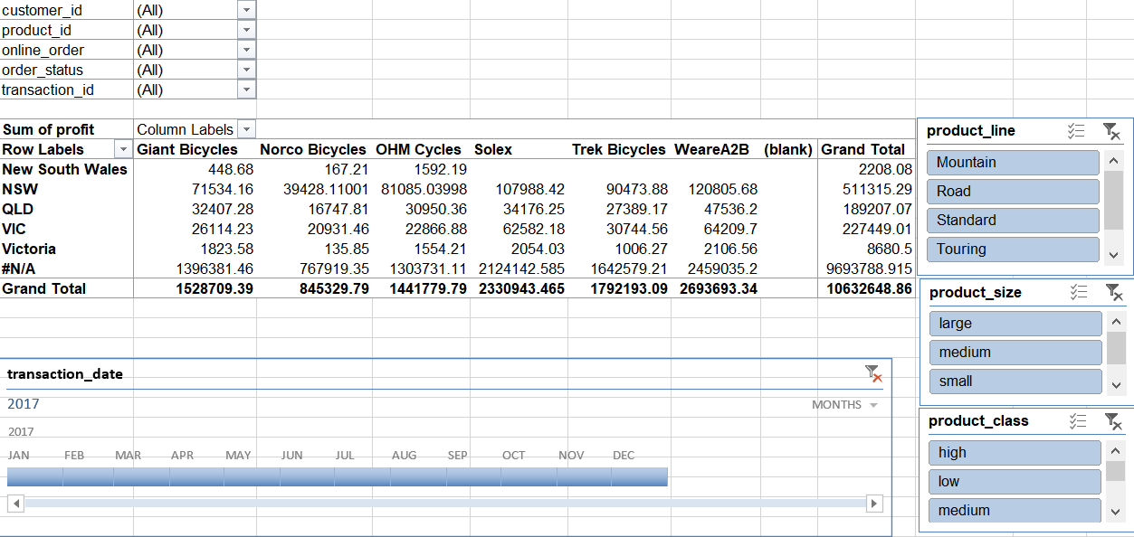
Introduction
Analysis
The following picture depicts the pivot table. It consists of filters, slicers and timeline.
It also depicts the sum of profit for each brand and it’s list price.

Slide 4
Data Exploration
Profit With Respect To Brand
The following graph depicts the sum of profit with respect to each Brand.
It also depicts the count of online orders for each brand and it’s list price.
The brand that procured the most profit and got the most number of online orders is Solex while the brand that procured least profit and got least number pf online orders is Norco Bicycles.

Slide 5
Data Exploration
Profit With Respect To State
The following graph depicts the sum of profit with respect to each State.
It also depicts the count of customer ids from each of the mentioned states.
The state that procured the most profit and got the most number of customers is New South Wales while the brand that procured least profit and got least number of customers is Victoria.

Slide 6
Data Exploration
New & Old Customer Distribution
Most customers are in 50 age group in New as well Old Customer details.
There are least number of customers in 20 and 90 age group.

Slide 7
Model Development
Profit With Respect To RFM Value and Customer Type.
RFM Value is used to determine which customers a business should target on in order to increase their sale and profit.
RFM (Recency, Frequency, Monetary) model shows customer that displayed high levels of engagement with business in the three mentioned categories.

Slide 8
Model Development
RFM Value Distribution
RFM Value is used to determine which customers a business should target on in order to increase their sale and profit.
RFM (Recency, Frequency, Monetary) model shows customer that displayed high levels of engagement with business in the three mentioned categories.

Slide 9
Note: The data and information in this document is reflective of a hypothetical situation and client. This document is to be used for KPMG Virtual Internship purposes only.
Interpretation
There are more number of customers in Platinum type category than that of Gold.
However, there are least number of customers in Bronze Category.
New State Wales procures large profit.
Solex brand procure large sales and thus large profit.

Slide 10
Note: The data and information in this document is reflective of a hypothetical situation and client. This document is to be used for KPMG Virtual Internship purposes only.
Appendix

Slide 11
Note: The data and information in this document is reflective of a hypothetical situation and client. This document is to be used for KPMG Virtual Internship purposes only.
Appendix
This is an optional slide where you may place any supporting items.

